Slide 1
Gameweek 2
Purpose, summary, results, squad, next actions

Slide 2
Purpose
To amass as many points in FPL using Data Driven Methods as far as possible
Side Goal 1: How can we better manipulate the data that was provided by Vaastav?
Answer: Learn some database management techniques

Slide 3
Summary of actions taken
Predict points with Linear Regression (ML)
Learn SQL from 7 Databases in 7 days book

Slide 4
Results
Predict points
R^2 of previous match’s form data is very low with the next week’s points gained
Learn SQL

Slide 5
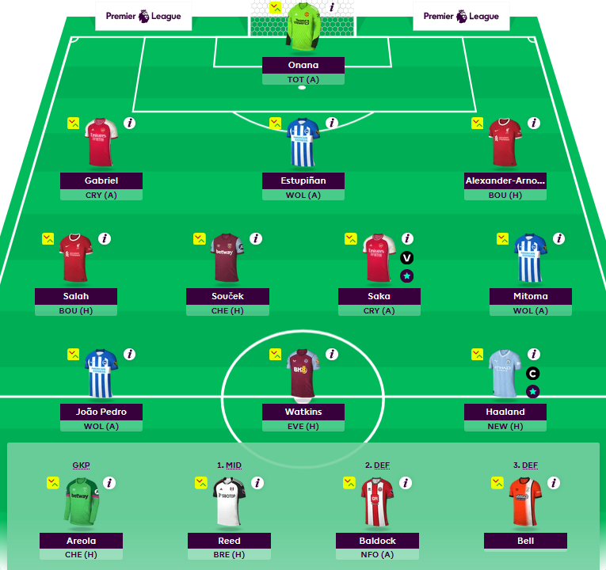
Squad
Stick with the same team

Slide 6
Next Actions
Who are the best people to transfer?
Someone whose transfer value is going up?
Good websites to follow
www.fantasyfootballscout.co.uk
https://www.youtube.com/watch?v=LzEuweGrHvc
Great talk by former winner with a mathematical perspective. Is his version of “modelling” the same as our linear regression? How can we implement it?

